Slide 1

Bioreactor System (User Interface):

Slide 2
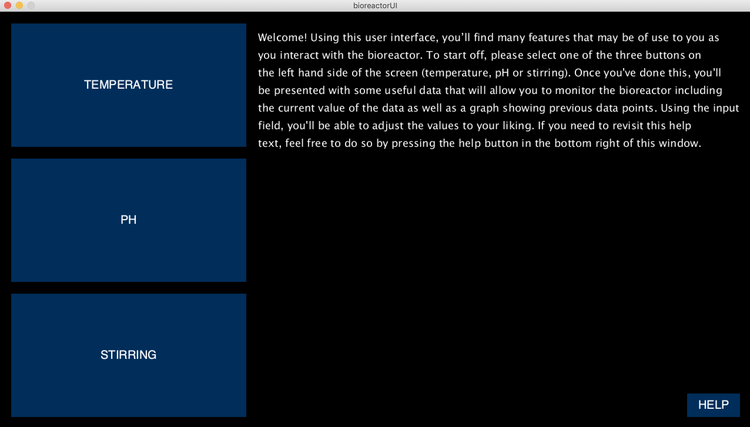
Overview of the UI:

Slide 3
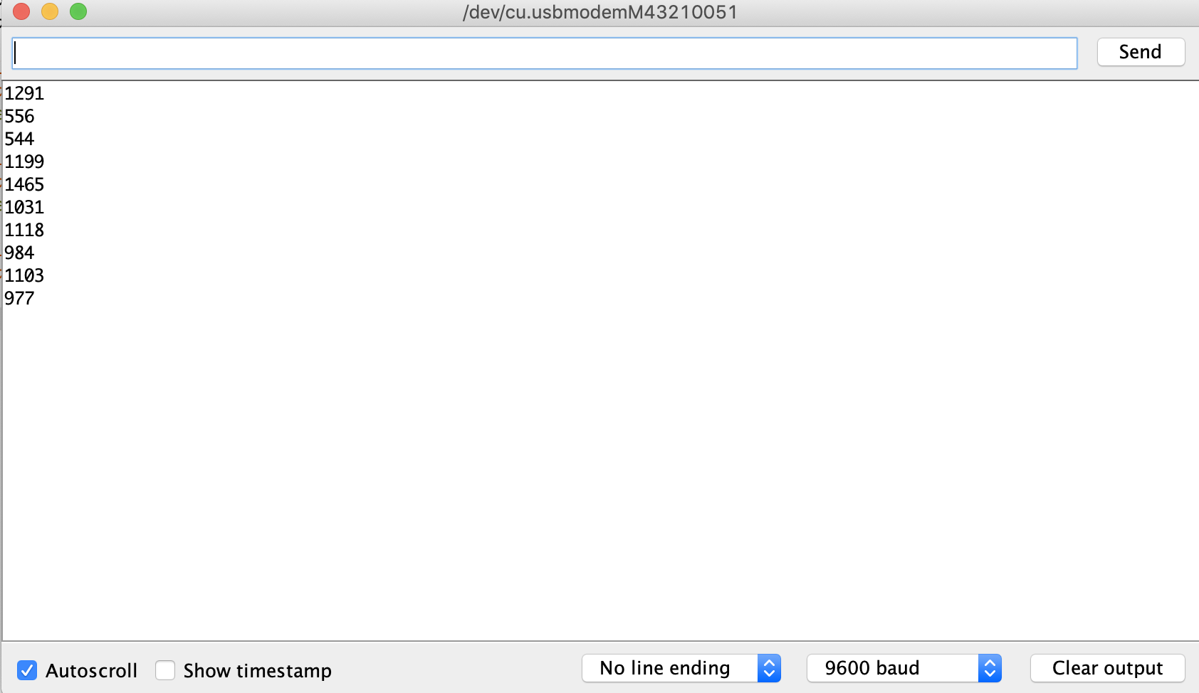
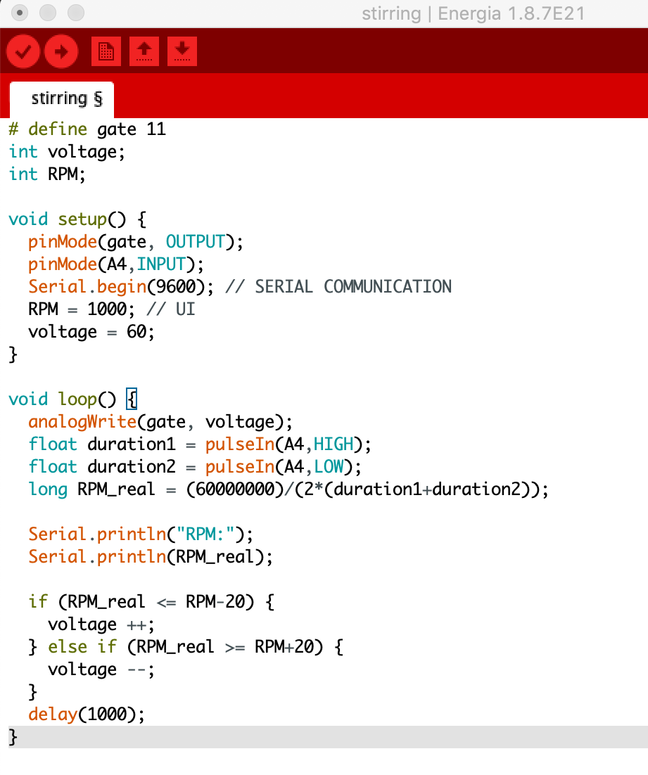
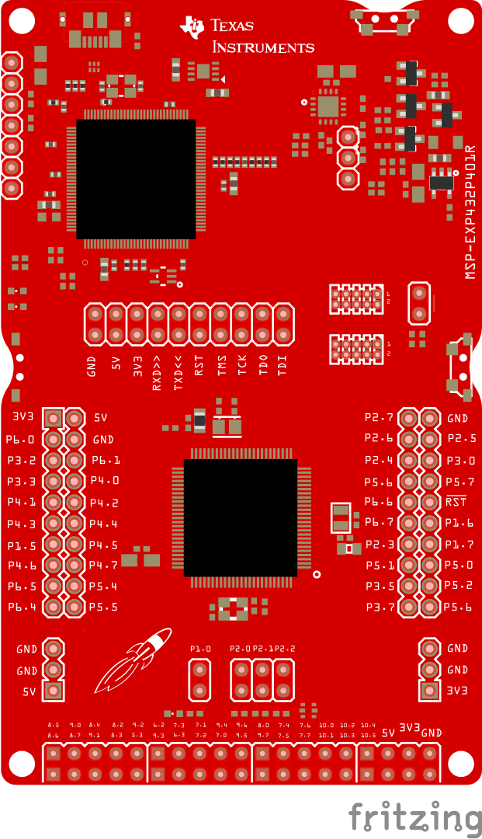
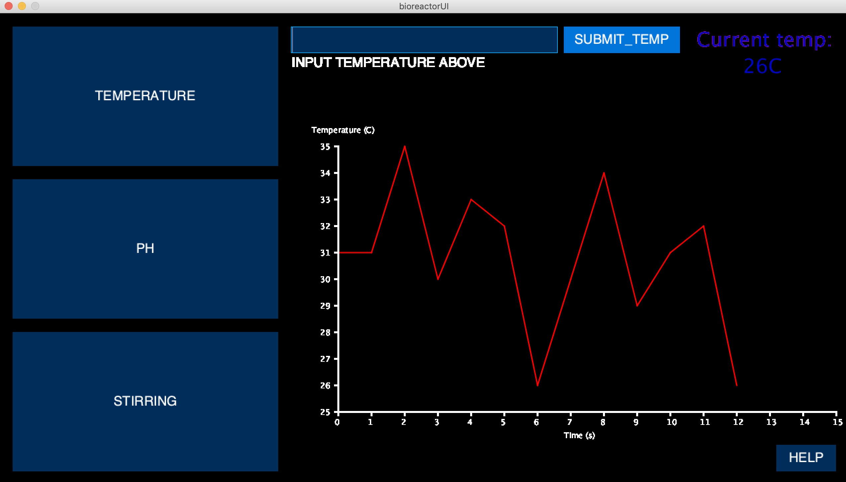
How the UI works:

Slide 4
Issues with the UI:
Two-way serial communication:
?

